Slide 1
Convolutional Neural Networks: Patterns Recognition & Interpretability
Amine BAAZZOUZ
Insights Data and Pricing Manager
at CIH BANK

Slide 2


Image recognition

Slide 3
How Computer ‘see’ image ?

Slide 4
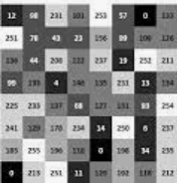
Pixel to numerical value
Computer vision
Input Image
Representation
Pixel values

Slide 5
Image patterns
Einstein
0.95
Bohr
0.01
Tunning
0.02
Nobel
0.02
Input Image
Representation pixel values
Classification

Slide 6
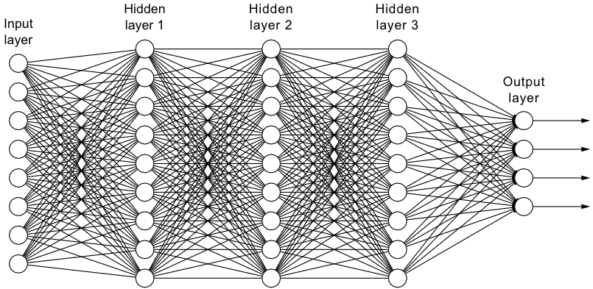
Learning Patterns
Fully connected Neural Network
Image
Class Prediction

Slide 7
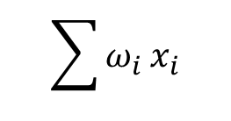
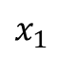
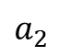
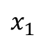
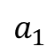
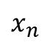
Learning Patterns
$$\sum{ω_{i}}x_{i}$$
$$x_{1}$$
$$a_{1}$$
$$x_{1}$$
$$a_{2}$$
Representation pixel values
Input Image
.
.
.
.
.
.
$$x_{n}$$
Connect neurons individually
Loosing Information
Many parameters

Slide 8
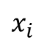
Connecting input pixels
$$x_{i}$$
Reducing Dimensions
Caption of Important Patterns

Slide 9
Connecting input pixels
Sliding Window Operation
Reducing Dimensions
Caption of Important Patterns

Slide 10
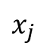
Connecting input pixels
$$x_{i}$$
Reducing Dimensions
Caption of Important Patterns
Weight the patch
$$x_{j}$$
What Operation to weight the patch?
Convolution

Slide 11
Convolution Operation: Exemple

Slide 12

Convolution operation
Input
Feature Map
21 | 19 | 17 | 25 | 28
71 | 76 | 73 | 68 | 59
153 | 164 | 164 | 157 | 155
200 | 201 | 190 | 185 | 180
205 | 210 | 215 | 230 | 232
Filter
x -1
x -1
x -1
-1 | -1 | -1
-1 | 8 | -1
-1 | -1 | -1
-74
x -1
x 8
x -1
x -1
x -1
x -1

Slide 13
Convolution operation
Input
Feature Map
21 | 19 | 17 | 25 | 28
71 | 76 | 73 | 68 | 59
153 | 164 | 164 | 157 | 155
200 | 201 | 190 | 185 | 180
205 | 210 | 215 | 230 | 232
Filter
x -1
x -1
x -1
-1 | -1 | -1
-1 | 8 | -1
-1 | -1 | -1
-74
-96
x -1
x 8
x -1
x -1
x -1
x -1

Slide 14
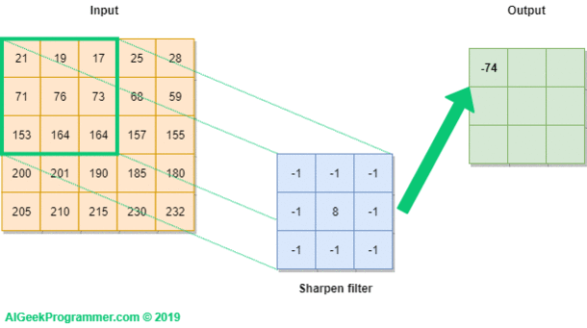
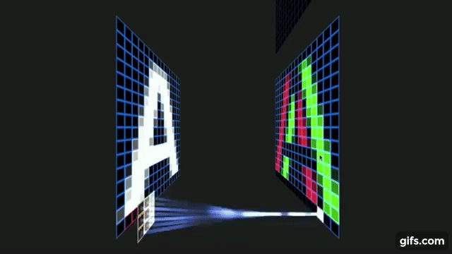
Convolution operation
Input
Feature Map
Filter

Slide 15
How does Black Box Look like?

Slide 16
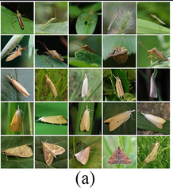
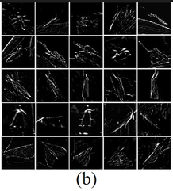


Feature Map Visualization
Inputs
Feature Maps
Convolution
torch.nn.Conv2d
Z. Liu et al. , « Localization and Classification of Paddy Field Pests using a Saliency Map and Deep Convolutional Neural Network», Nature portfolio, 2016

Slide 17
Activation Function & Maxpooling

Slide 18
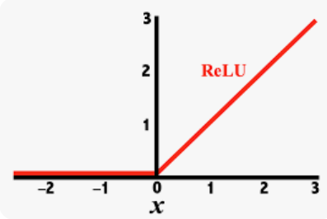
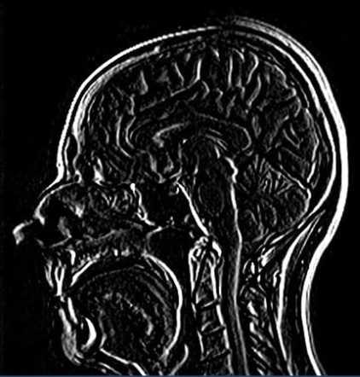
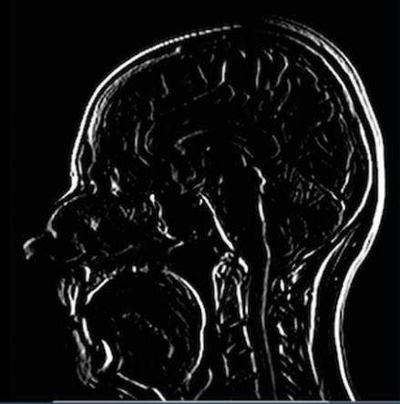
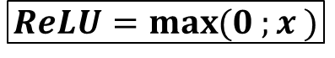
Activation Function
Rectified Linear Unit (ReLU)
Input Feature Map
Rectified Feature Map
ReLU
$$ReLU=\max{(0 ;x )}$$
Dark = negative values
Light= positive values
Only non-negative values
torch.nn.functional.relu

Slide 19
Max pooling Operation
Input Feature Map
Rectified Feature Map
12 | 20 | 30 | 0
08 | 12 | 2 | 0
34 | 70 | 37 | 4
112 | 100 | 25 | 12
2x2 Max Pooling

Slide 20
Max pooling Operation
Input Feature Map
Rectified Feature Map
12 | 20 | 30 | 0
08 | 12 | 2 | 0
34 | 70 | 37 | 4
112 | 100 | 25 | 12
2x2 Max Pooling
20
30
112
37
torch.nn.Maxpool2d

Slide 21
Convolution Neural Network

Slide 22

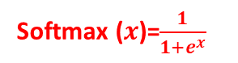
CNNs
Softmax ($x$)=$\frac{1}{1+e^{x}}$
0 | 0.001
1 | 0.001
2 | 0.980
3 | 0.001
4 | 0.005
5 | 0.001
6 | 0.002
7 | 0.001
8 | 0.006
9 | 0.003
Flatten
Convolution
Activation Function
Max pooling
torch.flatten
torch.nn.Conv2d
torch.nn.functional
torch.nn.Maxpool2d

Slide 23
Regrouping all puzzle pieces

Slide 24
import torch.nn as nn
import torch.nn.functional as F
class Net(nn.Module):
def __init__(self):
super().__init__()
self.conv1 = nn.Conv2d(3, 6, 5)
self.pool = nn.MaxPool2d(2, 2)
self.conv2 = nn.Conv2d(6, 16, 5)
self.fc1 = nn.Linear(16 * 5 * 5, 120)
self.fc2 = nn.Linear(120, 84)
self.fc3 = nn.Linear(84, 10)
def forward(self, x):
x = self.pool(F.relu(self.conv1(x)))
x = self.pool(F.relu(self.conv2(x)))
x = torch.flatten(x, 1) # flatten all dimensions
x = F.relu(self.fc1(x))
x = F.relu(self.fc2(x))
x = self.fc3(x)
return x
net = Net()

Slide 25
import torch.nn as nn
import torch.nn.functional as F
class Net(nn.Module):
def __init__(self):
super().__init__()
self.conv1 = nn.Conv2d(3, 6, 5)
self.pool = nn.MaxPool2d(2, 2)
self.conv2 = nn.Conv2d(6, 16, 5)
self.fc1 = nn.Linear(16 * 5 * 5, 120)
self.fc2 = nn.Linear(120, 84)
self.fc3 = nn.Linear(84, 10)
def forward(self, x):
x = self.pool(F.relu(self.conv1(x)))
x = self.pool(F.relu(self.conv2(x)))
x = torch.flatten(x, 1) # flatten all dimensions
x = F.relu(self.fc1(x))
x = F.relu(self.fc2(x))
x = self.fc3(x)
return x
net = Net()

Slide 26
import torch.nn as nn
import torch.nn.functional as F
class Net(nn.Module):
def __init__(self):
super().__init__()
self.conv1 = nn.Conv2d(3, 6, 5)
self.pool = nn.MaxPool2d(2, 2)
self.conv2 = nn.Conv2d(6, 16, 5)
self.fc1 = nn.Linear(16 * 5 * 5, 120)
self.fc2 = nn.Linear(120, 84)
self.fc3 = nn.Linear(84, 10)
def forward(self, x):
x = self.pool(F.relu(self.conv1(x)))
x = self.pool(F.relu(self.conv2(x)))
x = torch.flatten(x, 1) # flatten all dimensions
x = F.relu(self.fc1(x))
x = F.relu(self.fc2(x))
x = self.fc3(x)
return x
net = Net()

Slide 27
What did model learned?

Slide 28
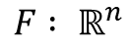
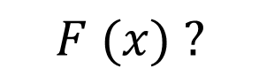
Interpretability of Neural Network
$$F : ℝ^{n}$$
[0;1]
Input Images
Classification
$$F (x) ?$$
…..
Convolutional Neural Network
Idea: Analysis of hidden units via neuron activations and explain how neurons influence the probability of classification

Slide 29

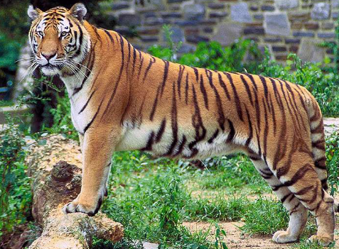
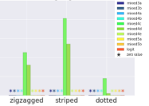






Interpretability of Neural Network
TCAV (Testing with Concept Activation Vectors)
B. Kim et al. , «Interpretability Beyond Feature Attribution: Quantitative Testing with Concept Activation Vectors (TCAV)», in International Conference on Machine Learning, pp. 2668–2677. PMLR, 2018
$$p(z)$$
Convolutional Neural Network
Tiger-ness
Concept: « Striped »
TCAV score
captum.concept.TCAV
captum.concept.Concept
https://captum.ai/

Slide 30
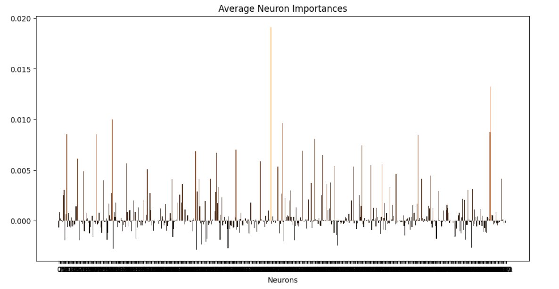
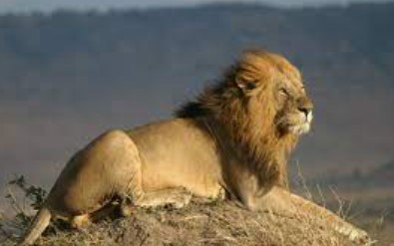
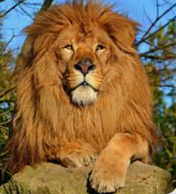
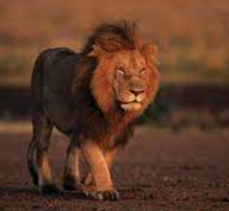
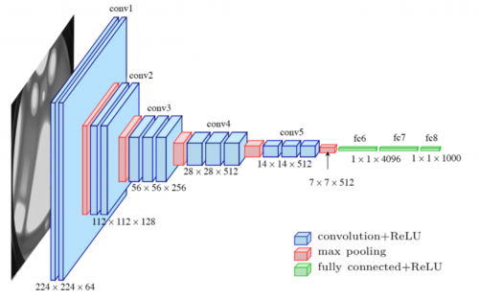
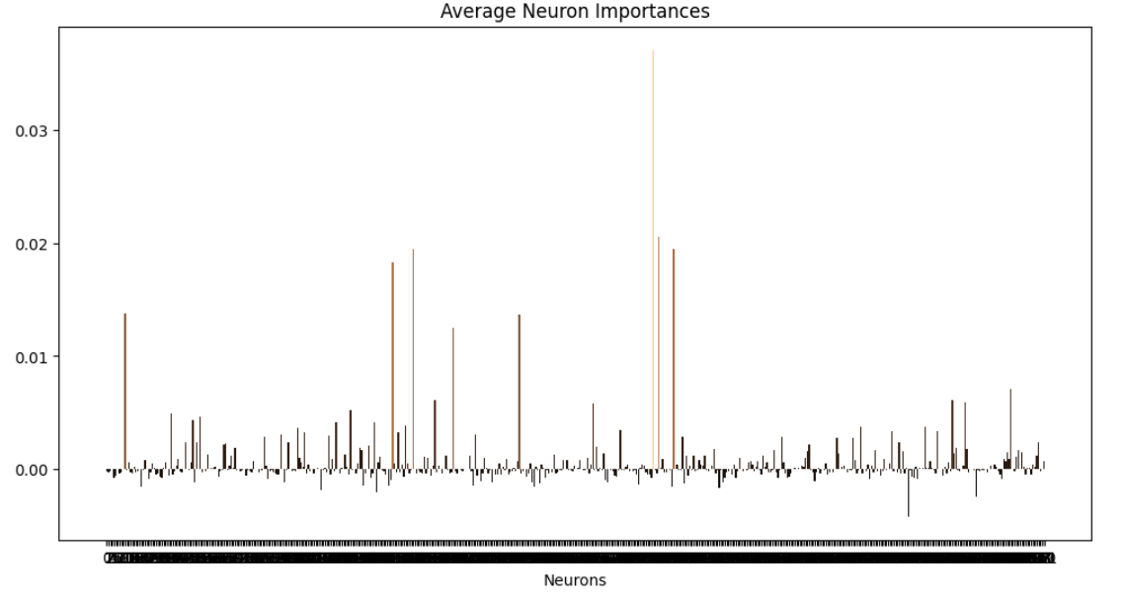
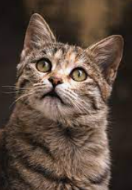
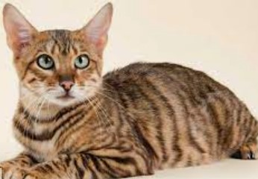
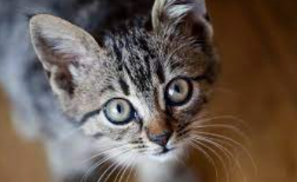
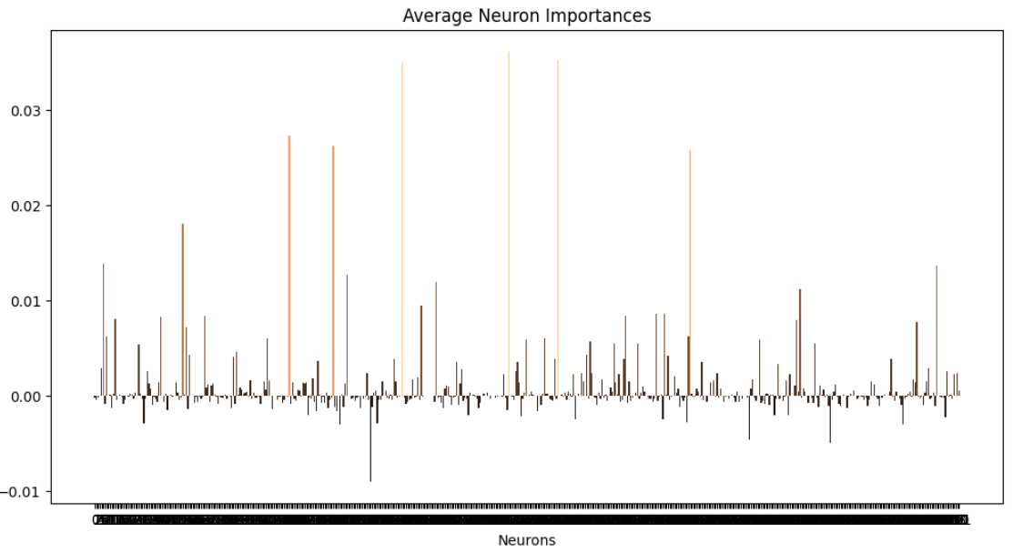
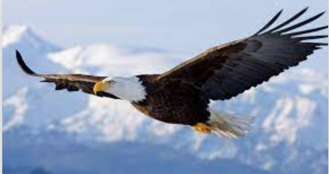
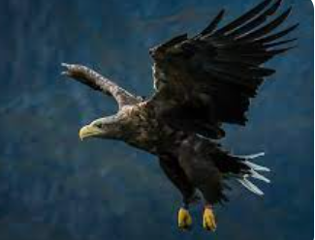
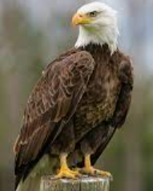
Interpretability of Neural Network
Layer Conductance
K. Dhamdhere, et al. , «How Important Neuron Is?», arXiv:1805.12233 , 2018
N° Class in « Imagenet »
Importance of neurons
Id=‘291’
Id=‘285’
Id=‘22’
captum.attr.LayerConductance.attribute
https://captum.ai/

Slide 31
Other architectures: AutoEncoder

Slide 32




AutoEncoder
$$W_{θ}$$
$$W_{θ′}$$
Latent space
$$x_{1}$$
X
X’
Input
Output
$$x_{n}$$
Bottleneck
Encoder
Decoder

Slide 33
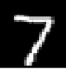


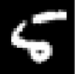
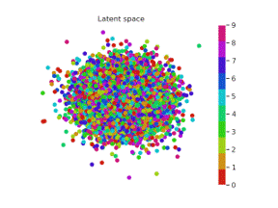
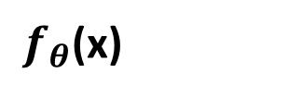
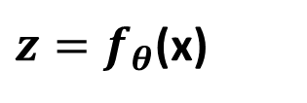
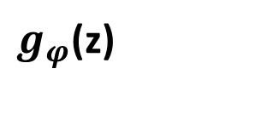
Latent space
${z=f}_{θ}$(x)
$f_{θ}$(x)
$g_{φ}$(z)

Slide 34

Latent space
${z=f}_{θ}$(x)
$f_{θ}$(x)
$g_{φ}$(z)

Slide 35
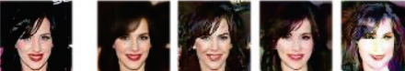
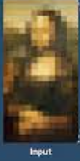
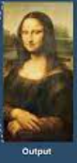
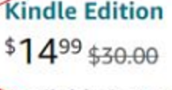
AutoEncoder: Applications
W. Xu et al., «Adversarially Approximated Autoencoder for Image Generation and Manipulation», IEEE Xplore, 2019
Image Generation
Input
Generated Images
B. Bajaj et al. , «Autoencoders Based Deep Learner for Image Denoising», Procedia Computer Science, Vol. 171, pp 1535-1541, 2020
Image Denoising
Price Promotion
A. Baazzouz, «Autoencoder for Consumer Perception of Price Promotion: Golden ratio as Latent Reference», IRJMETS, Vol. 4, Issue 10, 2022
Fraud Detection
S. Misra et al. , «An Autoencoder Based Model for Detecting Fraudulent Credit Card Transaction», Procedia Computer Science, Vol. 167, pp 254-262, 2020

Slide 36
Thanks

